Slide 1
30/10/-10/11/17 6th-7th week

Slide 2
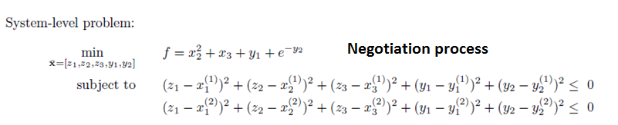
System optimization problem should be improved
Input:
Output:
Object function:
Design variables: (free to set)
No state variables

Slide 3
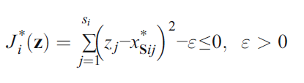
Relaxation method
In the relaxation method, the system level equality constraints are
replaced by inequality constraints:
where ε is the relaxed tolerance. However, it is a delicate job to determine a rational relaxed tolerance because solvability and consistency have conflicting requirements for the tolerance.
A variable relaxation method was developed (Li et al. 2008)

Slide 5
Global optimum = 12.5989
globalbest_Position
2.2412
0.6049
4.2328
8.0001
9.3024
Optimum = 7.9585
globalbest_Position
3.0248
0.0165
-0.0225
7.9779
5.8330

Slide 6
Conclusions
relaxation factors
The constraint sets in the system level make sense, is better than just .
Unequal to zero increases the numbers of iteration for the optimization process, in other words, the flexible search area leads to low search efficiency.
Many studies have indicated that the use of equality forms of system-level consistency constraints will necessarily causes the consistency-constraint Jacobean to vanish whenever the consistency constraints are satisfied. This implies it is difficult to find a system-level optimization solution that satisfies both the standard KKT conditions and consistency constraints.

Slide 7


(1) Relaxation method and variable relaxation method
In the relaxation method, the system level equality constraints are
replaced by inequality constraints:
where ε is the relaxed tolerance. However, it is a delicate job to determine a rational relaxed tolerance because solvability and consistency have conflicting requirements for the tolerance.
A variable relaxation method (Li et al. 2008) and a mixed relaxation (MR) method (Yang et al. 2017) were developed.

Slide 8
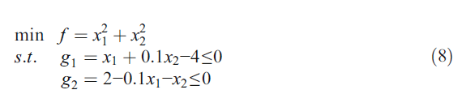
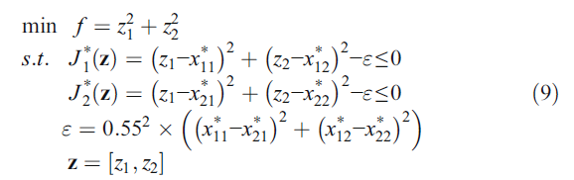
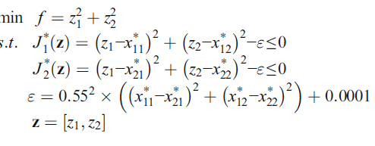
For example
The problem:
The system level ( have the same formulates for subspaces)
If it is too small, it will fail to work as expected; on the contrary, if the value is too large, it will be not conducive to the consistency of the optimal solutions between system level and subsystem level.

Slide 9
Feasibility problem of final solution
When the relaxation method is employed, the system level equality constraints are relaxed and the inconsistency between system level and subsystem level for the shared variables is allowed.
An important issue followed is that the final optimal solution of CO may not be a real feasible solution, for it may not be able to yield the constraints of the original optimization problem. Because the constraints of the original problem are assigned as subsystem-level local constraints, and they are achieved only in subsystem-level optimization process.

Slide 10
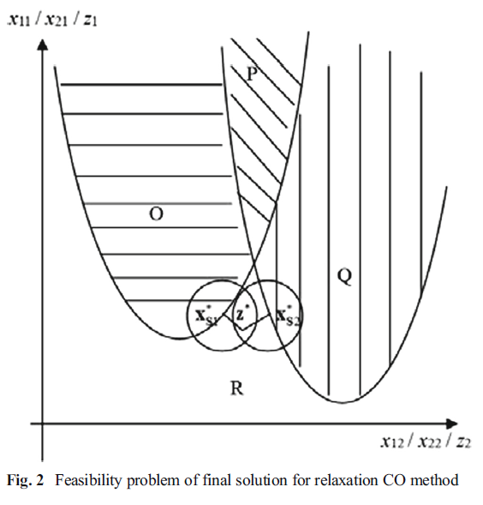

Slide 11
(2) Enhanced Collaborative Optimization
Roth, B., & Kroo, I. (2008, September). Enhanced collaborative optimization. In 12th AIAA/ISSMO Multidisciplinary Analysis and Optimization Conference, Victoria, BC.
The key idea in this approach is to include models of the global objective and all of the subspace constraints in each subspace optimization problem while maintaining the low dimensionality of the system level problem.
Each subspace needs to make a line model of the other subspace’s constraints which needs a global knowledge at the beginning of optimization. The need of global knowledge of all participants seems impossible.
To achieve compatibility between subspaces (obtain the average of the target responses returned from the subspaces)
System
Sub 1
Sub 2
Do the most of design decisions, each subspace needs to know the disciplines of all other subspaces.
No communication but a priori knowledge

Slide 12
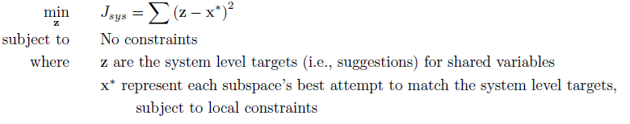
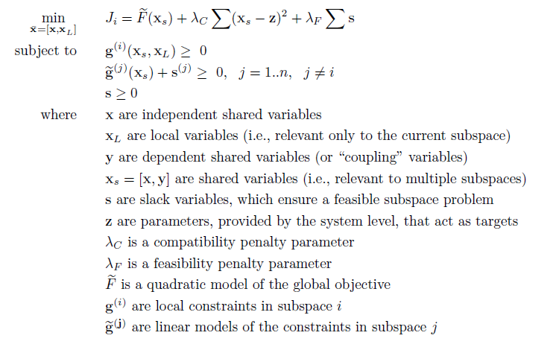
It is easy for the system but hard for the subspace.
The global objective + a quadratic measure of compatibility + a set of slack variables

Slide 13
Improved CO
Response surface technology (Sobieski et al. 1998; Sobieski and Kroo 2000; Jun et al. 2004)
The relaxation method (Alexandrov and Lewis 2002; Li et al. 2008). RCO, MRCO, MRMCO
Penalty function method (Lin 2004).
Enhanced CO(Rothand Kroo 2008) ECO

Slide 14
Communication mechanism in original CO and what we can improve?
The system still needs all information from its subspaces to calculate the next target values at each iteration (synchronous). Although it is improved by collecting the outputs of subspaces and make an independent optimization problem instead of those at once methods which need to have a system analysis for all disciplines.
If the connection between any subspace and the system is lost, CO fails to obtain the final optimum.
What we can do to improve this situation?
System
System
Sub 1
Sub 2
Sub 1
Sub 2

Slide 15
The basic question
Is it good or not to provide direct interaction among the subspaces? Or compared to the original CO, in which the interaction among subspaces are realized by indirect ways through a virtual system platform, it seems like the original indirect interaction has better robustness. If there is some disadvantages in this indirect mechanism, maybe the low communication efficiency. Inspired from ant colony optimization, for a great number of participants, indirect interaction however, is really an effective communication way.
The system like the third part which shows justice to both sides, avoiding cheating, occasional mistake and confusion.
System
System
Sub 1
Sub 2
Sub 1
Sub 2

Slide 16
Multilevel Self-organised Optimization
Here the basic idea is, the direction interaction should only appear in local groups, or local neighbours. Here the local neighbours are defined not by Euclidean distance, but dependence distance.
Then the global optimization problem becomes self group making, and a final unitary group means the global optimum.
The optimization process could be regarded as the emergence of a unitary group which concludes all participates’ benefit and leads to a compromise.
The idea is inspired from the emergence of the primary city-state.
4
4
4
System
4
2
3
3
2
5
1
3

